Slide 1
Algorithms for Near-term Intermediate Scale Quantum Computers
9th December 2025

Slide 2
Why use today’s quantum computers?
General considerations for NISQ
A short overview of NISQ algorithms
  Annealing
  Sampling
  Analog quantum simulation
  Variational Algorithms
Building blocks of Variational Algorithms
  Objective functions
  Parameterized circuits
  Measurements
  Parameter Optimization
Variational Quantum Algorithms
  QAOA, VQE, QML
Theoretical Challenges

Slide 3
Why use today’s quantum computers
We can roughly state that today’s machines have around 100 qubits and both they and the operations on them are subject to errors.
Since these machines exist the ethos has been to make algorithms that work now but are expected to scale to fault tolerance.
It might be possible to find a quantum advantage even in the presence of noise.
Historical literature: Quantum Computing in the NISQ era and beyond - John Preskill
https://quantum-journal.org/papers/q-2018-08-06-79/

Slide 4
The goals of NISQ
The experimental pursuit in the NISQ era would focus on the design of quantum hardware with a larger number of qubits, and gates with lower error rates capable of executing deeper circuits.
Demonstrate quantum advantage for practical use cases.
  If the NISQ paradigm is not powerful enough to exhibit any quantum advantage, theoretical pursuits would be required to understand its limitations.
The prime direction of the NISQ and near-term era is to engineer the best possible solution with the limited quantum resources available.
The tools and techniques invented during this period could be valuable in the faul tolerant era as well.
Notes:
We expect experimental pursuit in the NISQ era would focus on the design of quantum hardware with a larger number of qubits, and gates with lower error rates capable of executing deeper circuits. Along the way, one of the goals is to demonstrate quantum advantage for practical use cases. If the NISQ paradigm is not powerful enough to exhibit any quantum advantage, theoretical pursuits would be required to understand its limitations. The prime direction of the NISQ and near-term era is to engineer the best possible solution with the limited quantum resources available. The tools and techniques invented during this period could be valuable in the faul tolerant era as well.
Reached in 3 ways
Hardware development
Algoerithm design
Application problems

Slide 5
Considerations in NISQ
Noise and Errors in the machines
  Covered in depth – but noise and errors must be accounted for in some way.
Limited number of qubits
Qubits have limited coherence
  Technically falls in the error category, but this is a hard limit to the depth of circuits
Hardware specific design for circuits
Carefully chosen problems

Slide 6
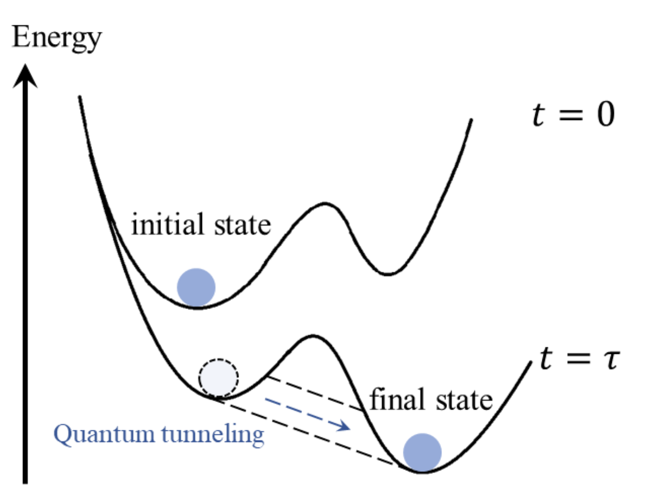
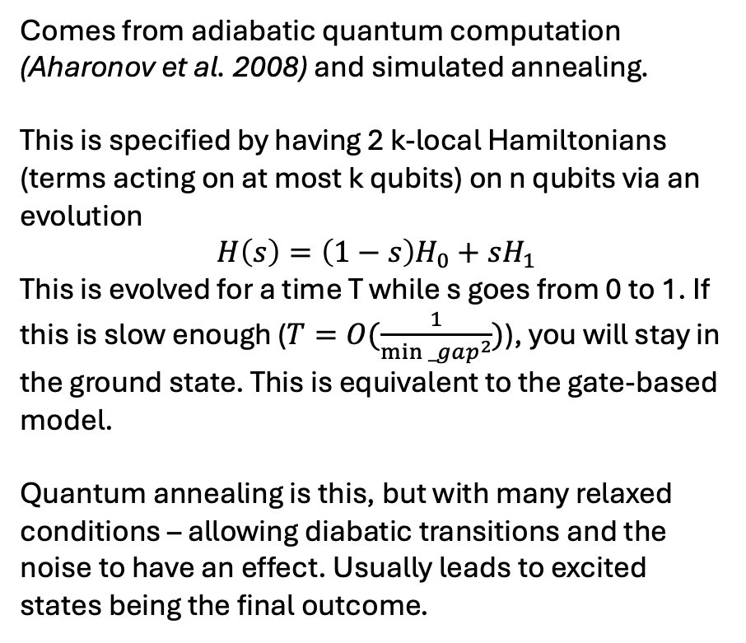
Quantum annealing
Comes from adiabatic quantum computation (Aharonov et al. 2008) and simulated annealing.
This is specified by having 2 k-local Hamiltonians (terms acting on at most k qubits) on n qubits via an evolution
$$H\left(s\right)=\left(1−s\right)H_{0}+sH_{1}$$
This is evolved for a time T while s goes from 0 to 1. If this is slow enough ($T=O(\frac{1}{min⁡_gap^{2}})$), you will stay in the ground state. This is equivalent to the gate-based model.
Quantum annealing is this, but with many relaxed conditions – allowing diabatic transitions and the noise to have an effect. Usually leads to excited states being the final outcome.

Slide 7
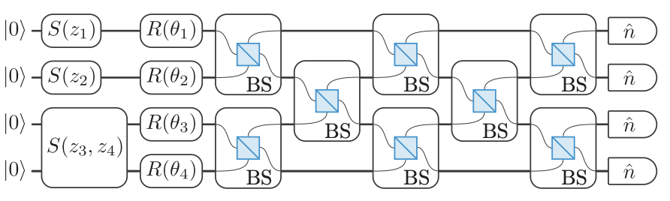
Sampling problems
First quantum advantages were claimed thorugh this – specifically Boson Sampling. We have n photons entering a circuit of m modes, various phase shifters impart some phase to each mode’s amplitude and then the number of photons are counted in each mode. This distribution is hard to compute classically – other sampling problems exist, but the idea is that these probability distributions are hard for classical computers – but they do not necessarily lead to practically useful results.

Slide 8
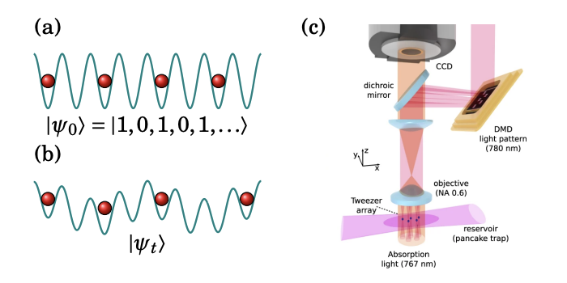
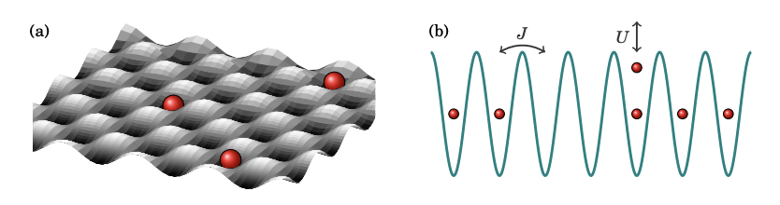
Analog quantum simulation
Here a setup that is analogous to some physics problem is made, generally as an optical field on which particles are placed, and these will interact with their existing physics – and the resulting states can be measured. The optical field can be altered to reflect problem parameters.
This used to be limited in the Hamiltonians it could simulate, but can be made digital as well.

Slide 9
Variational Algorithms
This is a catch all class of algorithms that has been very succesfull in QC – and encompasses all algorithms where the variational principle is used.

Slide 10
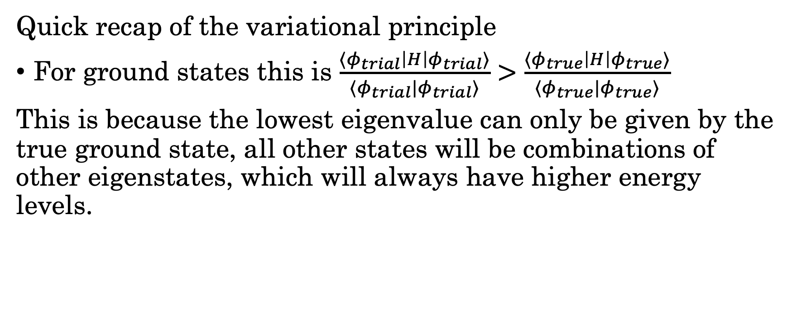
Building blocks
Quick recap of the variational principle
For ground states this is $\frac{⟨φ_{trial}\left|H\right|φ_{trial}⟩}{⟨φ_{trial}|φ_{trial}⟩}>$ $\frac{⟨φ_{true}\left|H\right|φ_{true}⟩}{⟨φ_{true}|φ_{true}⟩}$
This is because the lowest eigenvalue can only be given by the true ground state, all other states will be combinations of other eigenstates, which will always have higher energy levels.

Slide 11
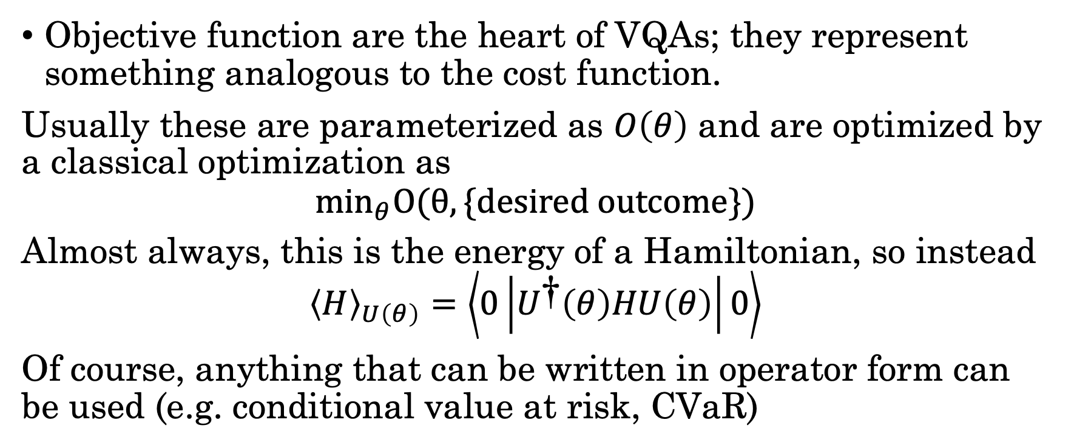
Objective functions
Objective function are the heart of VQAs; they represent something analogous to the cost function.
Usually these are parameterized as $O\left(θ\right)$ and are optimized by a classical optimization as
$${\text{min}}_{θ}O(θ,\{desired outcome\})$$
Almost always, this is the energy of a Hamiltonian, so instead
$${\left\langle H\right\rangle }_{U\left(θ\right)}=\left\langle 0\left|U^{\text{†}}\left(θ\right)HU\left(θ\right)\right|0\right\rangle$$
Of course, anything that can be written in operator form can be used (e.g. conditional value at risk, CVaR)

Slide 12
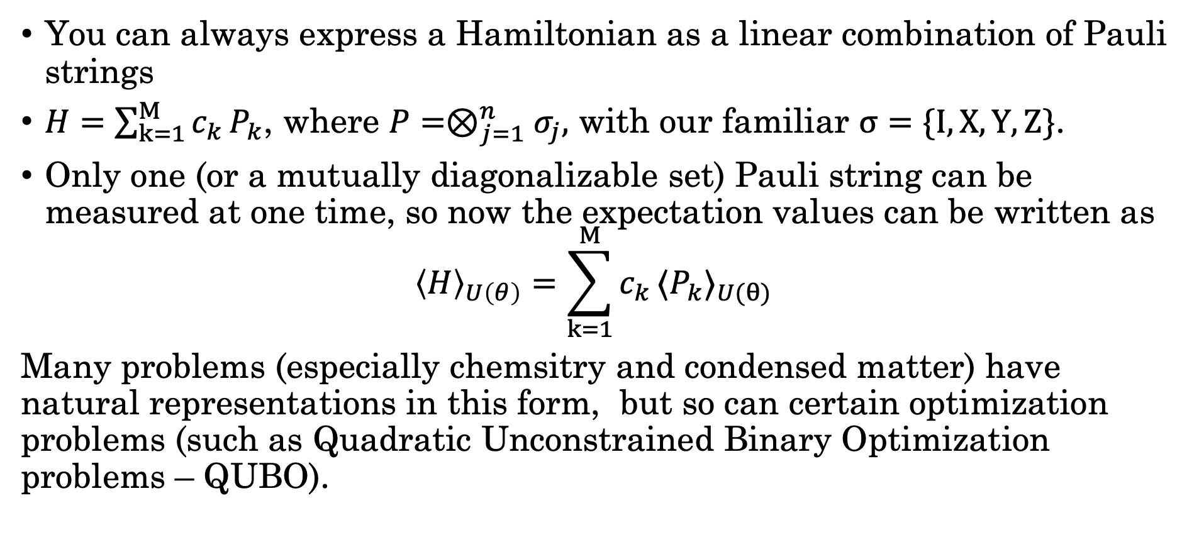
Pauli Strings
You can always express a Hamiltonian as a linear combination of Pauli strings
$H=\sum_{k=1}^{M}{c_{k}}P_{k}$, where $P=⊗_{j=1}^{n}σ_{j},$ with our familiar $σ=\{I,X,Y,Z\}$.
Only one (or a mutually diagonalizable set) Pauli string can be measured at one time, so now the expectation values can be written as
$${\left\langle H\right\rangle }_{U\left(θ\right)}=\sum_{k=1}^{M}{c_{k}}{⟨P}_{k}〉_{U(θ)}$$
Many problems (especially chemsitry and condensed matter) have natural representations in this form, but so can certain optimization problems (such as Quadratic Unconstrained Binary Optimization problems – QUBO).

Slide 13
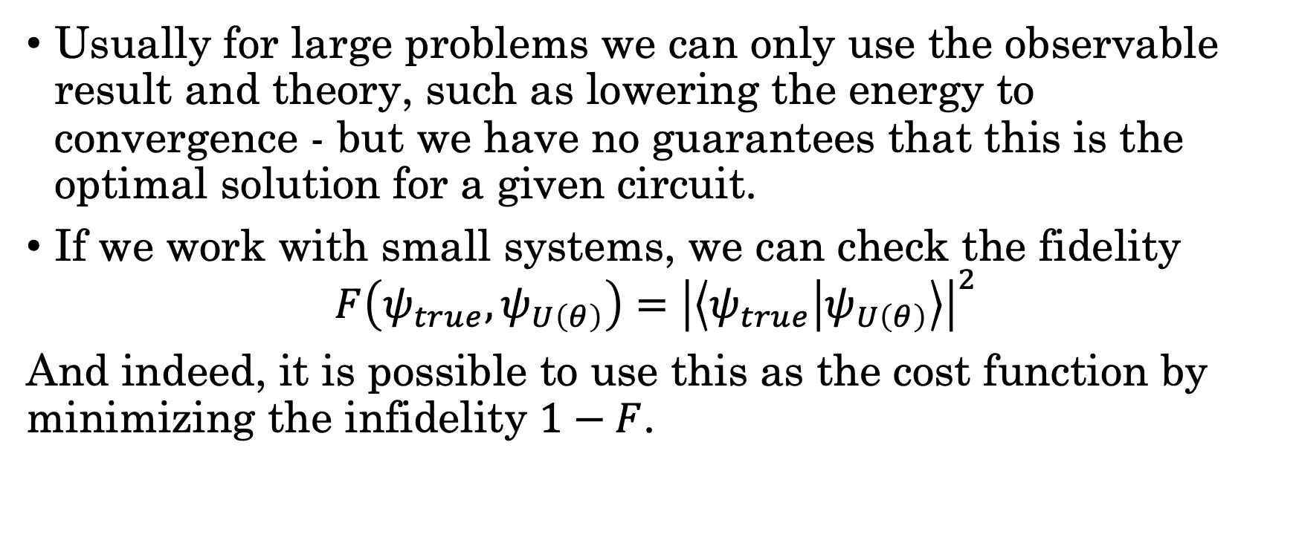
Measures of quality
Usually for large problems we can only use the observable result and theory, such as lowering the energy to convergence - but we have no guarantees that this is the optimal solution for a given circuit.
If we work with small systems, we can check the fidelity
$$F\left(ψ_{true},ψ_{U\left(θ\right)}\right)={\left|\left\langle ψ_{true} | ψ_{U\left(θ\right)}\right\rangle \right|}^{2}$$
And indeed, it is possible to use this as the cost function by minimizing the infidelity $1−F$.

Slide 14
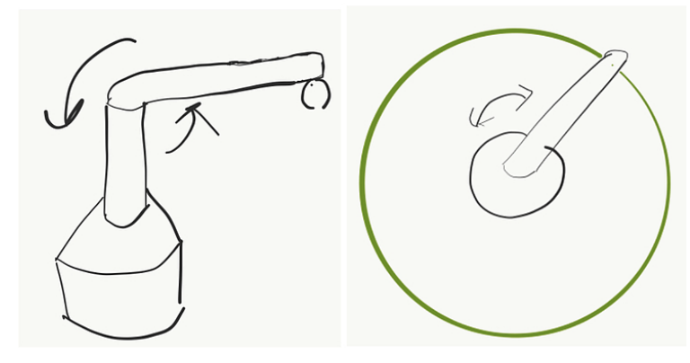
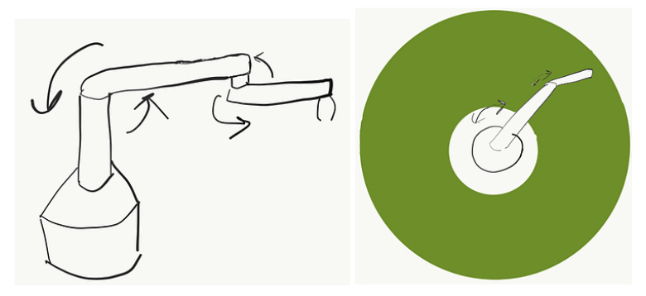
Parametertized circuits
Parameterized quantum circuits are, in full generality, any unitary U that is parameterized. This can always be converted into a circuit representation.
As you add more parameters you can reach more states, think og adding rotating segments to a robotic arm

Slide 15




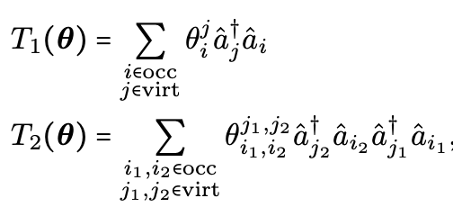
Problem inspired ansatze
Since we can synthesize any unitary, with knowledge of the physics we can propose circuits that are guaranteed by theory to at least reach certain states. In general any Hermitian matrix can be made unitary
For example, pauli matrices
Famously this has been done for Unitary Coupled Cluster in chemistry, where the Cluster Operator T acts on a simple product state

Slide 16
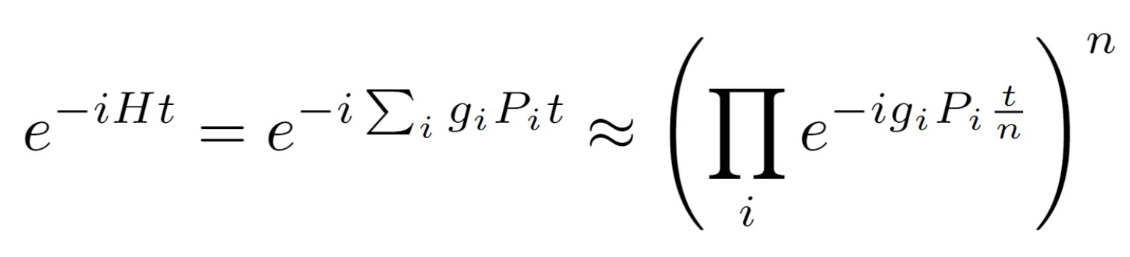
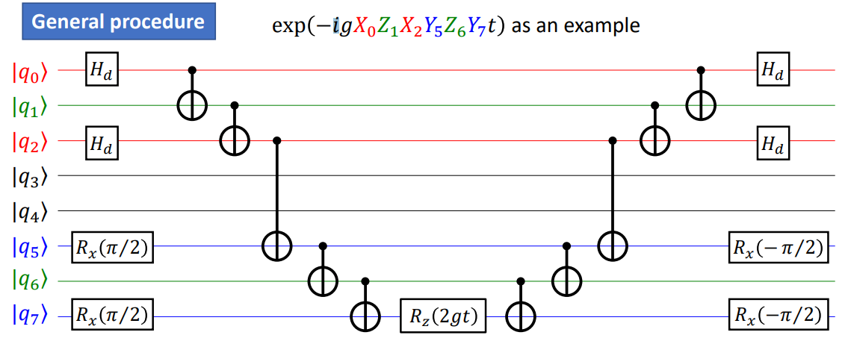
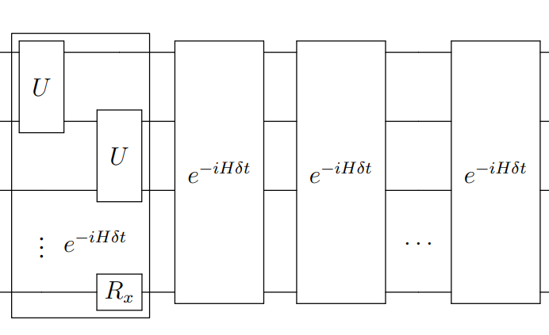
And these can be converted to circuits in general via the Suzuki Trotter decomposition
N
2
3
J
1

Slide 17
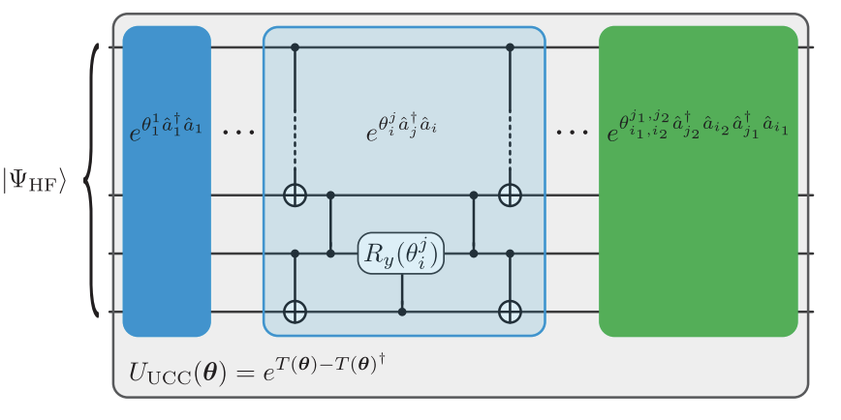
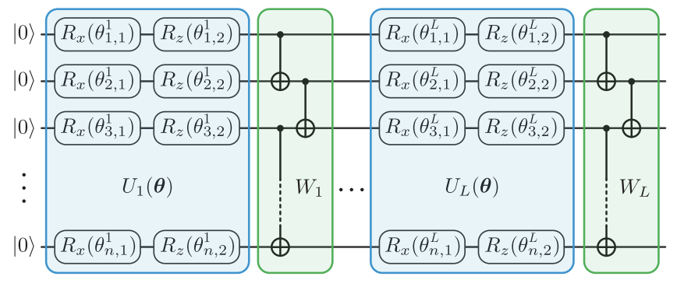
Hardware constrained ansatze
But these circuits are usually very deep and have complex connectivity requirements, as such it is normal to use gates that exist on the machine heuristically.
Problem inspired Hardware efficient

Slide 18
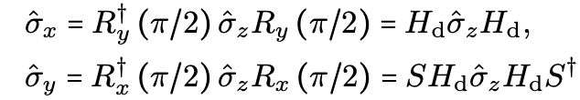
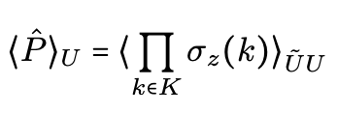
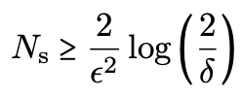
Measurement
How do we actually measure the pauli strings? We naturally measure in the Z basis, but you may remember from the first lectures that we can convert easily between these
This must be done for each qubit individually according to the terms of the pauli string
We need to sample. for an error epsilon and failure probability delta

Slide 19

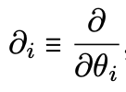

Parameter optimization
To solve for these we need to do some form of gradient descent. These can be gradient free (will not be discussed) or gradient based approaches. This is similar to updating machine learning parameters, using a simple rule like
The simplest way is via finite differences,
but one can use any classical techniques like L-BFGS.
However the quantum computer can be used to get analytical gradients!

Slide 20


Parameter shift rule
It turns out that by modifying one parameter at a time in a clever way is enough to get gradients.
However this requires two runs per circuit for every single parameter and you have to measure all required expectation values at each parameter shift!

Slide 21
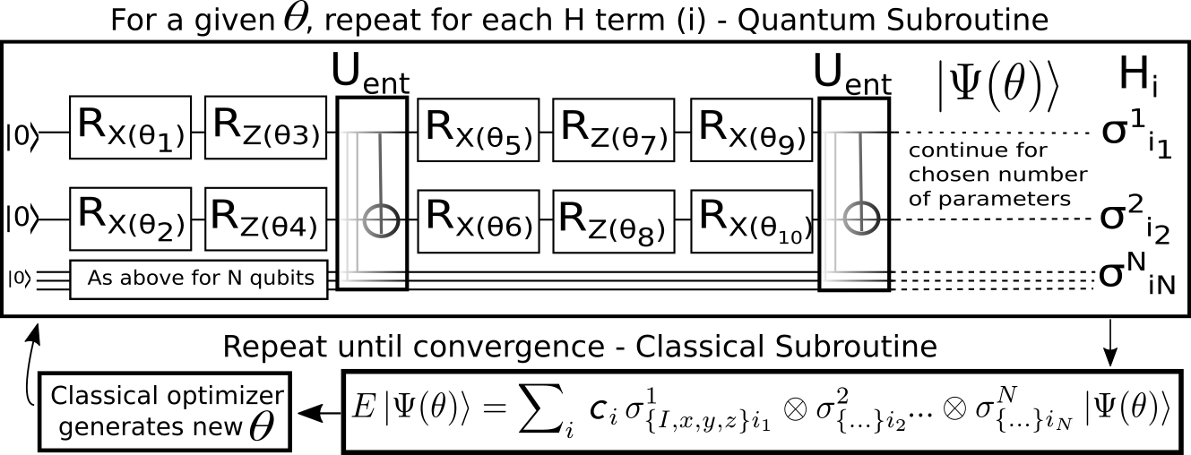

Variational Quantum Eigensolver
If you combine all we talked about in full generality we get the VQE, which is the first NISQ algorithm used to solve for hydrogen.
$$\left\langle ψ\left|H\right|ψ\right\rangle ≥$$
$$\left\langle ψ_{0}\right|H|ψ_{0}⟩$$

Slide 22
Quantum Approximate Optimization Algorithm - QAOA
One of the few NISQ algorithms with analytical results. From a complexity theory lens – the algorithm collapses the polynomial hierarchy, which could mean that advantage could be found.
The types of problems that it is good for are those where you are searching for an optimal bitstring – so in a way it is a conceptual mix of Grover’s search and the quantum adiabatic algorhithm

Slide 23
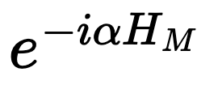
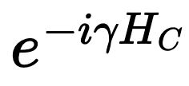
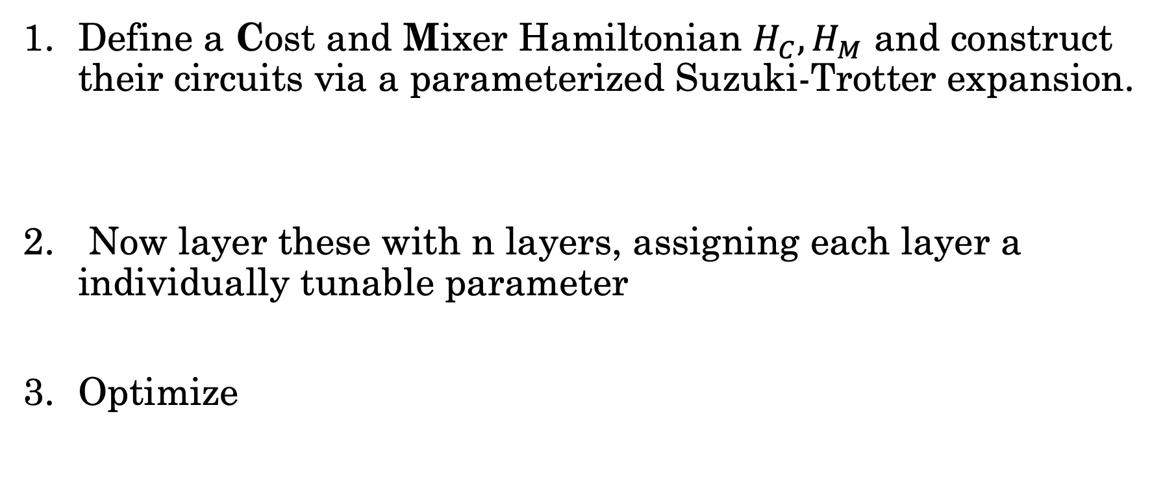
The algorithm
Define a Cost and Mixer Hamiltonian $H_{C},H_{M}$ and construct their circuits via a parameterized Suzuki-Trotter expansion.
Now layer these with n layers, assigning each layer a individually tunable parameter
Optimize

Slide 24
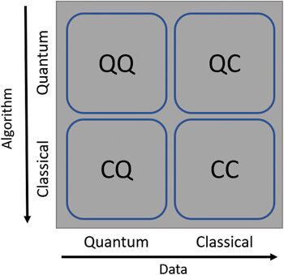
QML
QML is much too wide to properly cover, but we can make some distincitons with what part(s) is(are) quantum.

Slide 25
Some examples
Variational classifiers are just a VQA that is trained to output a
  classification bitstring
Data reuploading classifiers are ones that take advantage of the fact that one can use a single qubit with arbitrary dimensional data and use it as a universal classifier (Perez et al., https://arxiv.org/abs/1907.02085)
Quantum reservoir computing is the quantum version of reservoir computing, where the quantum computer acts as a non-linear ‘reservoir’ whose inputs are tuned so that it can produce time series.
Many basic ML architectures have analogues on quantum computers.
There is no proof that these will be better than classical.

Slide 26
Theoretical Limits – Barren Plateaus
We touched on this – there are two types
  Noise induced
  Ansatz induced
Noise induced ones are unavoidable in the presence of enough noise
Ansatz induced ones come from the fact that we have an exponentially growing space, and this makes parameters have a minimal effect, so we have to minimize the Hilbert space explored to prove that these don’t exist for a given ansatz, but this is difficult in general https://www.nature.com/articles/s41467-018-07090-4

Slide 27
Theoretical Limits - Expressibility
Expressibility is the ability for an ansatz to explore the Hilbert space – you can think of it as the manifold it can explore.
It is the capability of a parameterized model to approximate a family of solutions – since Parameterized Quantum Circuits are a subset of unitary operations, is there a configuration capable of approximating any unitary. If so
  How accurately can this be done?
  How many gates are needed?
  Can we exploit structure?

Slide 28
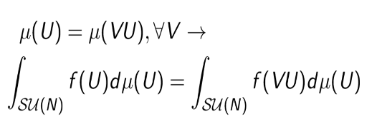

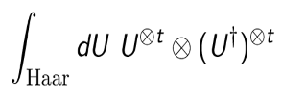
Fortunately there are tools!
One can compute the Haar Measure which is how like a given unitary’s parameter space is compared to the uniform distribution of unitaries over the space of unitaries
Another method people study is how the probability distributions match the t-th statistical moment (1 is mean, 2 is variance) – known as the t-design
Sadly there is a free choice in the measures that allows one to artifically increase or decrease the expressivity.

Slide 29

Theoretical Limits - Reachability
This is simlar to expressivity, but you ask how well a parameterized circuit can represent the true state.
The difference is in the selectivity of only measuring with respect to the true answer rather than how well it can explore the space of possibilities. This has only really been analyzed in depth for QAOA and variational Grover search.

Slide 30
Tools at our disposal
To improve results of NISQ algorithms we really only have the following knobs:
Error Mitigation
Circuit compilation
Algorithmic/Ansatz choices
  Type of optimization
  Clever ansatze

Slide 31
An example of a more complex VQA
We will now go through a VQA known as time dependent variational quantum propagation to show a full workflow of an algorithm, including results and issues that arise.

Slide 32
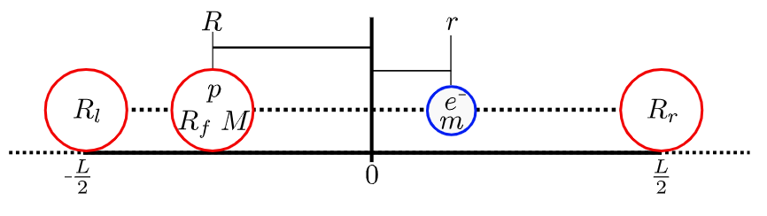

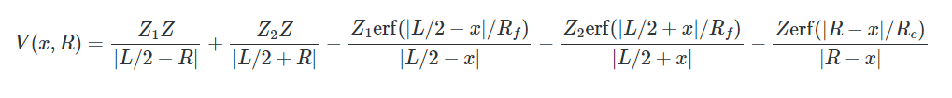
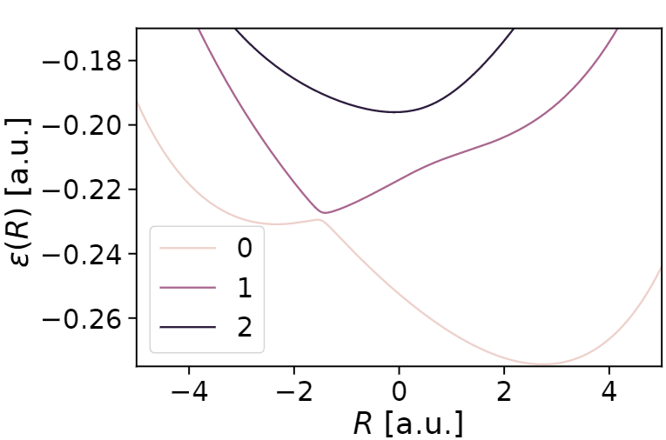
THE SHIN-METIU MODEL
Notes:
Change the Hamiltonian!

Slide 33
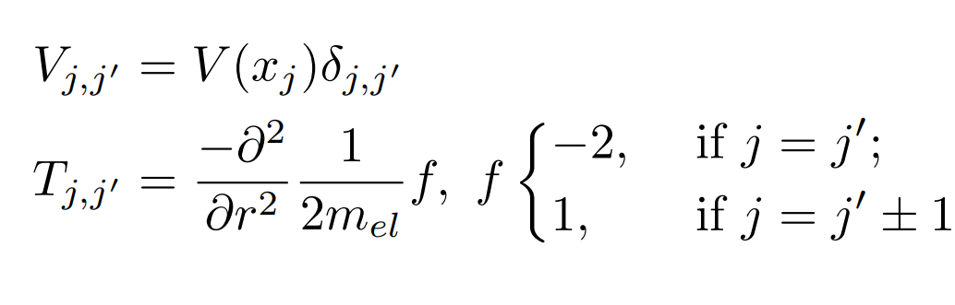
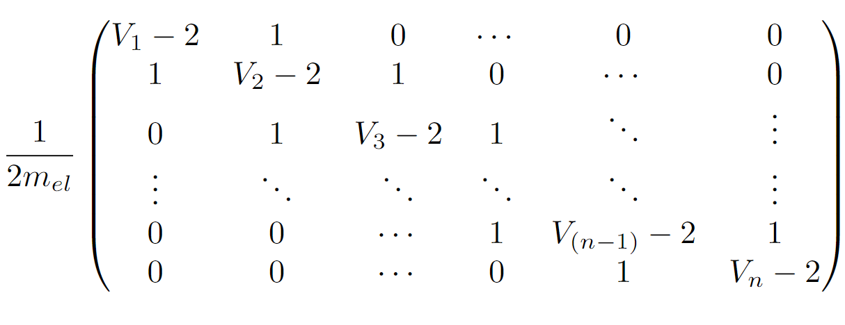


Encoding the Model
$$|0..0⟩$$
2^{qubits} grid points
$$|1..1⟩$$
Central finite differences
Notes:
DO not add any additional information, just what you actually did

Slide 34
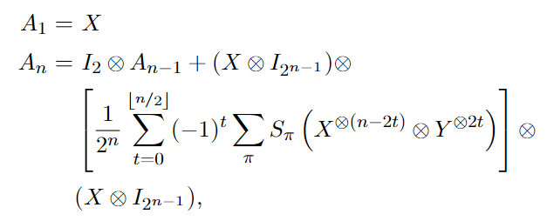
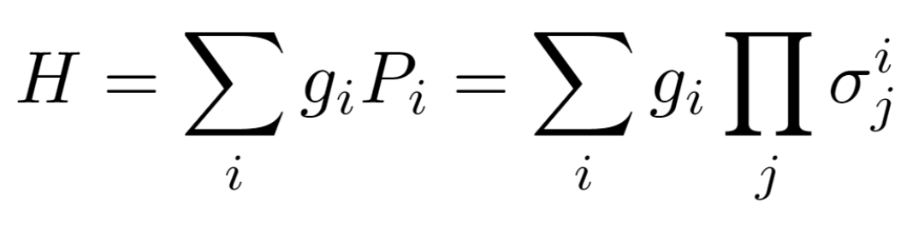
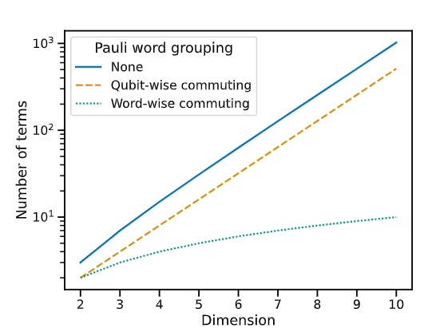
Representing the Hamiltonian
Recursive relation for tridiagonal Hamiltonians
For example, Pauli strings like
g1XYII+ g2XIYI …
Notes:
But Hamiltonians are not unitary, they are Hermitian. Fortunately, you can always take the imaginary exponential

Slide 35
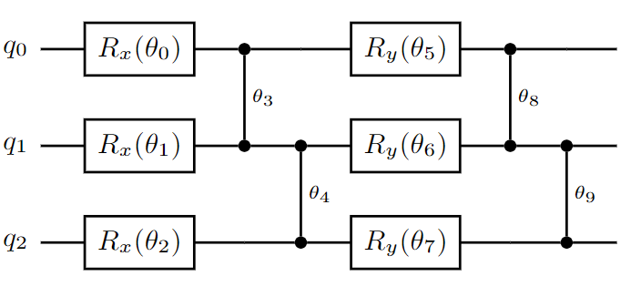
The Time Dependent Variational Quantum Propagation Algorithm
1. Choose a parameterized circuit as an ansatz

Slide 36



2. Prepare your desired initial state –
Variational Quantum Eigensolver
$$Σ_{i}$$
$$H_{t=1}^{i}$$
Minimize $θ$

Slide 37


3. Evolve
$$Ψ_{t=2}$$
$$e^{−iH_{t=1}Δt}$$
Trotter Circuit

Slide 38


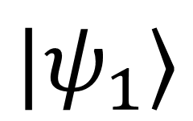
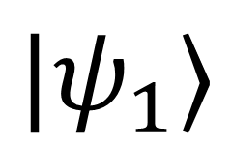
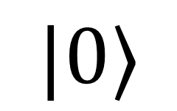
$$|ψ_{1}⟩$$
$$|ψ_{1}⟩$$
3. compress
$$|0⟩$$
$$≠$$
$$e^{−iH_{t=1}Δt}$$

Slide 39




4. Measure Observables
$$\{O_{i}^{\left(s\right)}\}$$
$$e^{−}$$
$$F_{i}$$
$$\{O_{i+1}^{\left(s\right)}\}$$

Slide 40




5. Update Classical system and Hamiltonian
Velocity Verlet or any other integrator
$$\{O_{t=i}^{\left(s\right)}\}$$
$$e^{−}$$
$$\frac{F_{i}Δt^{2}}{2M}+v_{i}Δt$$
$$\{O_{t=i+1}^{\left(s\right)}\}$$
$$H_{t=i+1}$$

Slide 41
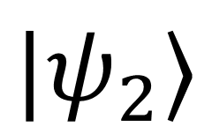

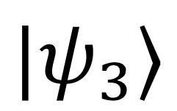
$$|ψ_{2}⟩$$
$$|ψ_{3}⟩$$
$$e^{−iH_{t=2}Δt}$$

Slide 42

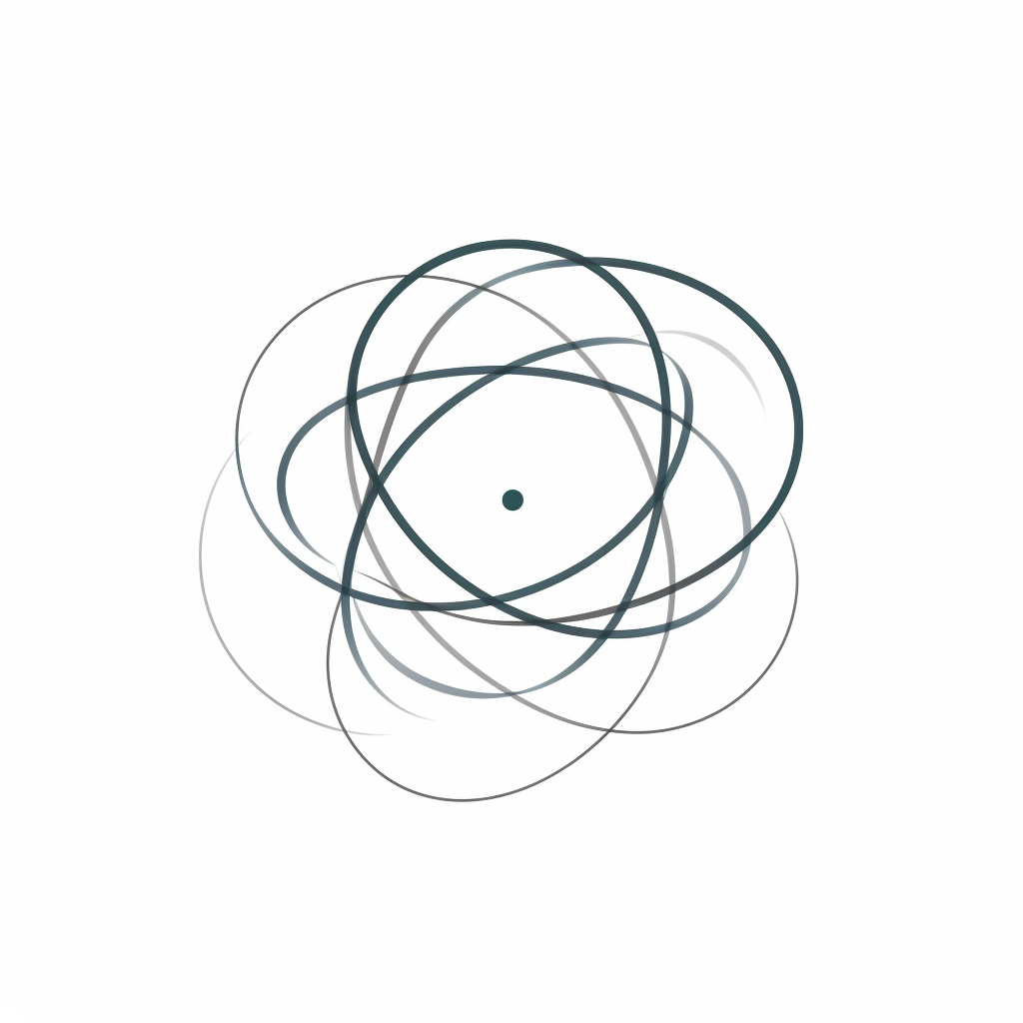
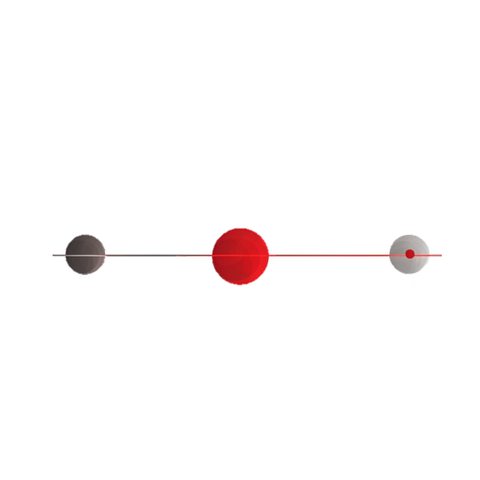
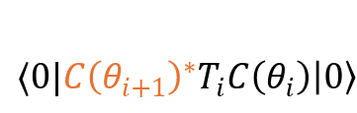


















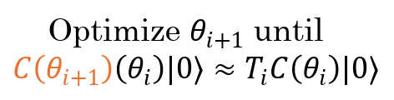



Initialization
Evolution
$$C(\overline{θ_{i}})|0⟩$$
$$T_{i}C\left(θ_{i}\right)\left|0\right\rangle$$
$$≈|ψ_{i}⟩$$
$$T$$
$$≈|ψ_{i+1}⟩$$
Extraction
$${H(q}_{i})≔H_{i}$$
Compute “Efficient” Time Evolution Circuit
$$\{O_{i}^{\left(s\right)}\}$$
$$\dot{q_{i}}$$
$$T_{i}≈e^{−iH_{i}Δt}$$
$$\frac{−L}{2}$$
$$q_{i}$$
$$\frac{L}{2}$$
Update classical system based on $\{O_{i}^{\left(s\right)}\}$
and generate $\left\{{\hat{O}}_{i}^{\left(s\right)}\right\}.$
Checkpointing
$${\dot{q}}_{i+1}$$
$⟨0|{C{\left(θ_{i+1}\right)}^{∗}T}_{i}C\left(θ_{i}\right)\left|0\right\rangle$
$$q_{i+1}$$
$$T$$
and generate $H_{i+1}$and $\{{\hat{O}}_{i+1}^{\left(s\right)}\}$
Start to end runtime:
Optimize $θ_{i+1}$ until
$${C\left(θ_{i+1}\right)\left(θ_{i}\right)|0⟩≈T}_{i}C\left(θ_{i}\right)|0⟩$$
16 1000 100 70 + 8 7,000,000

Slide 43


Noiseless Results, from Ground State
Potential Energy Surface Reminder
Run for 1000 timesteps of 0.5 [a.u.]
Quantitively good for short time scales
Qualitative at higher iteration counts
Relatively slow fidelity decay
Fidelity

Slide 44






Noiseless sources of error
Optimizer has finite iterations and threshold
Cumulative Error on Observable
Infidelity
2 timesteps per [a.u.]
$$\prod_{i}^{iterations}{\text{Treshold} \text{reached} \text{at} i}$$
Exact versus exact with hardcoded force error
Error here scales as
Notes:
In the cumulative error with observables the theory on just velocity verlet predicts that there is a power law relation with both cases, and indeed, even through the simulation algorithm this is the case as evidenced by the straight lines on a log-log plot.

Slide 45

Sources of Error – Finite Sampling
2 timesteps per [a.u.]

Slide 46

In summary
All VQA algorithms fit into a program that has this general structure when run on a real machine

Slide 47
Conclusion
Most NISQ digital quantum computing is some form of VQA
It is uncertain whether these will lead to advantages
People are moving away from NISQ algorithms, however.
https://quantumalgorithmzoo.org/ for a list of most known quantum algorithms in general!

